Slide 1
College Cafeteria Website

Slide 2
OUR MENTOR
MR. Bhanu Kapoor
~TECHNICAL TRAINER~

Slide 3
OUR TEAM
Rishabh Tiwari
Sakshi Tiwari
Design the idea of project, handled the features, meals, testimonials, form section.
Design and Development of navigation bar using HTML and CSS, handled plan, cities, steps section.

Slide 4
TABLE OF CONTENTS
01
02
03
04
Introduction
Software Design
User get all the information regarding places they want to visit..
A dataflow diagram has been made to show the working of website..
Testing
Implementation
Tanslating design specification into source code.
Full-Fledged responsive website ..

Slide 5
INTRODUCTION

Slide 6
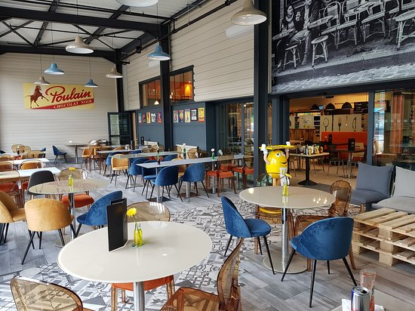
OVERVIEW
The Cafeteria Project is a new initiative that aims to improve the overall customer experience in the cafeteria. Our goal is to create a user-friendly, efficient, and modern front-end system that will make it easy for customers to place orders, pay for their meals, and receive their food quickly.

Slide 7

MOTIVATION
Our team has conducted extensive research to understand the needs and preferences of our cafeteria customers. We have also analyzed the current system to identify areas of improvement.
Based on the requirements gathered, our team has designed a new user interface that is intuitive, visually appealing, and easy to navigate. We have also ensured that the new design is responsive, meaning it will work seamlessly on desktop and mobile devices.

Slide 8

PROJECT PLAN
Objective : To build Cafeteria Website using HTML, CSS ,JavaScript and MongoDB. As a Small meal is very much required for refreshing ones mood we have created it at very friendly rate so that people can afford it and enjoy the best time of their life.
Scope : User get all the quality content regarding famous dishes of cafe. User can also get to see overall reviews.

Slide 9
01
Software Requirements

Slide 10



SOFTWARE REQUIREMTS
60%
30%
HTML
CSS
Structure of the webpage
Complete design of the webpage
10%
JAVASCRIPT
Created netword-centric application

Slide 11

HTML
HTML is an acronym which stands for Hyper Text Markup Language which is used for creating web pages and web applications.
HTML describes the structure of a web page.
HTML consists of a series of elements.
HTML elements tell the browser how to display the content.
HTML elements label pieces of content such as “this is heading” , ”this is a paragraph” , “this is a link” , etc.
A simple HTML Document:-
<!DOCTYPE html>
<html>
<head>
<title>WEB DEVELOPMENT</title>
</head>
<body>
<h1>Heading</h1>
<p>Paragraph</p>
</body>
</html>

Slide 12

css
CSS stands for Cascading Style Sheets.
CSS describes how HTML elements are to be displayed on screen, paper, or in other media.
CSS is used to define styles for our web pages, including the design, layout and variations in display for different devices and screen sizes.
The word cascading means that a style applied to a parent element will also apply to all the children elements within the parent. So if we set the color of the body text to “blue”, all headings , paragraphs and other text elements within the body will also get the same color(unless we specify something else).
CSS can be added to HTML document in 3 ways:-
INLINE:-by using the style attribute inside html elements.
INTERNAL:-by using a <style> element is <head> section.
EXTERNAL:-by using a <link> element to link to an External CSS file.

Slide 13
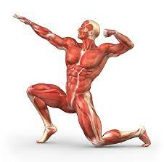
JAVASCRIPT
JavaScript is a programming language that is one of the core technologies of the World Wide Web, alongside HTML & CSS.
JavaScript is used to create dynamic and interactive web content like applications and browsers.
Some examples of JavaScript applications:-
Web And Mobile Apps
Game Development
Server Applications

Slide 14
02
Software Design

Slide 15
03
System Testing

Slide 16
NAVIGATION BAR

Slide 17
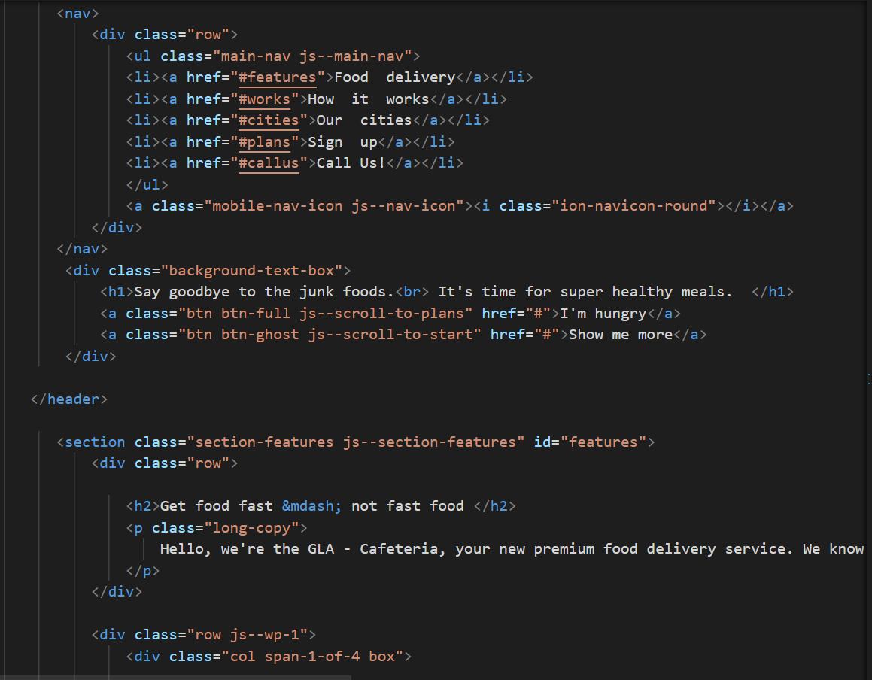

Slide 18
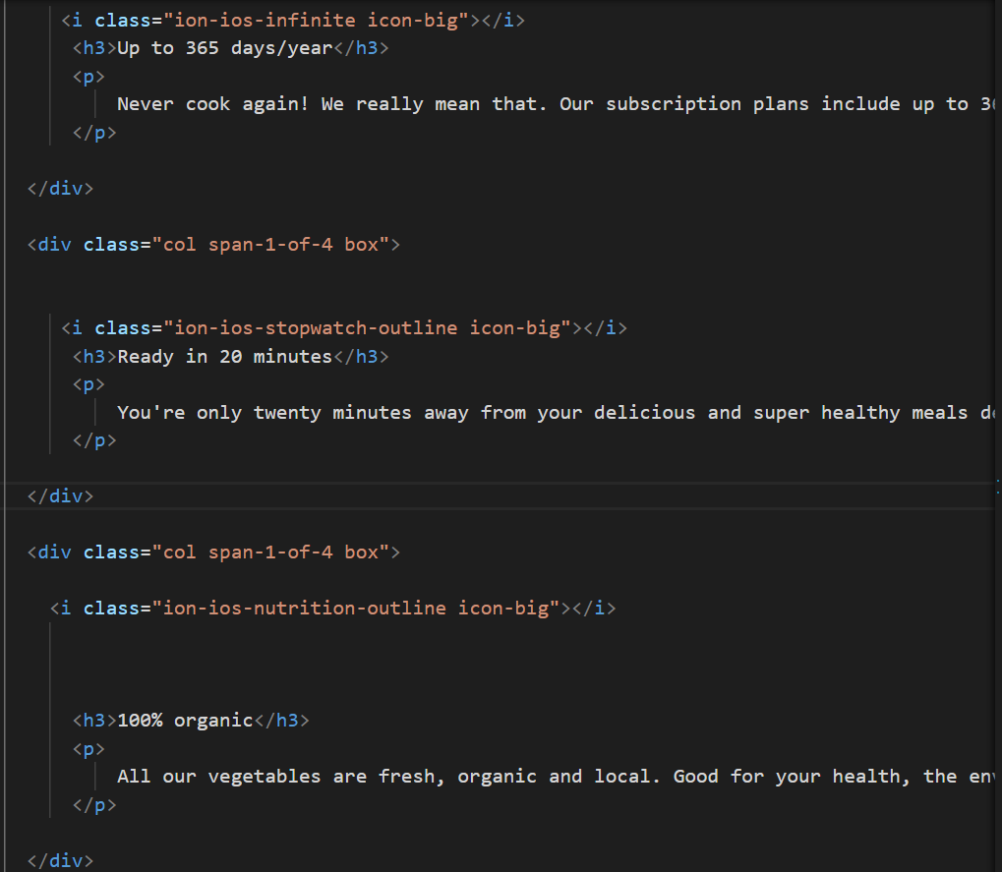

Slide 20
Media Query

Slide 21
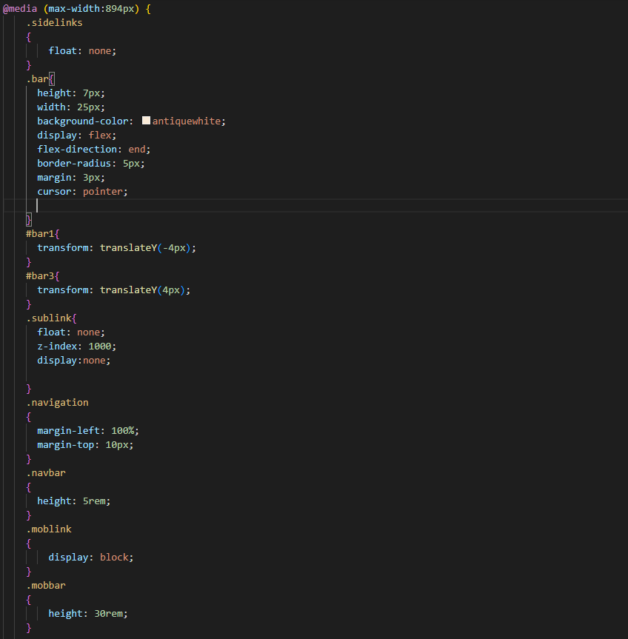

Slide 22
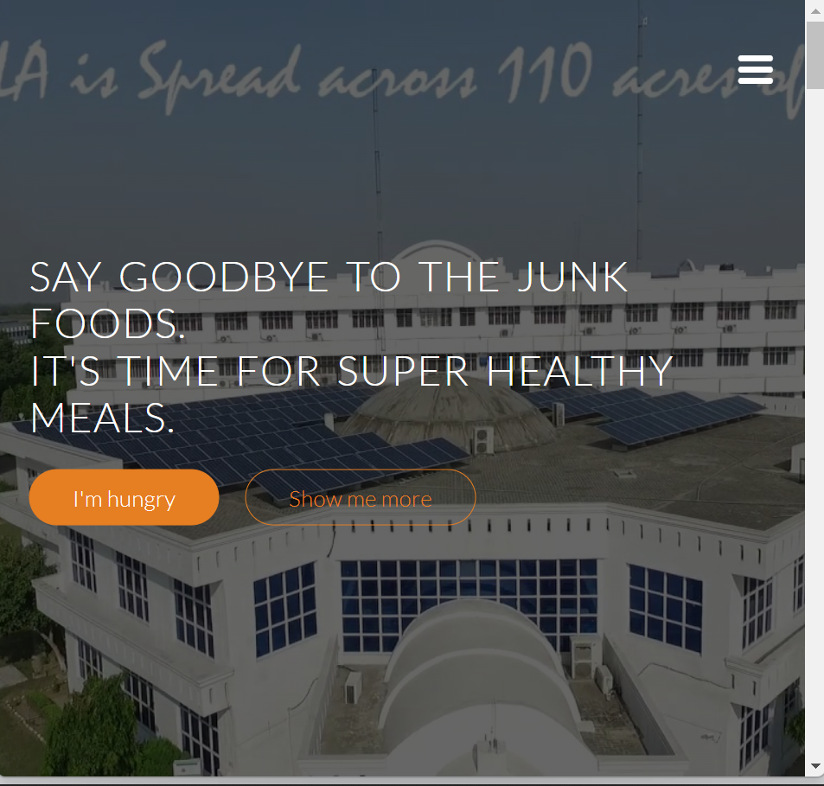

Slide 23
FOOTER

Slide 24
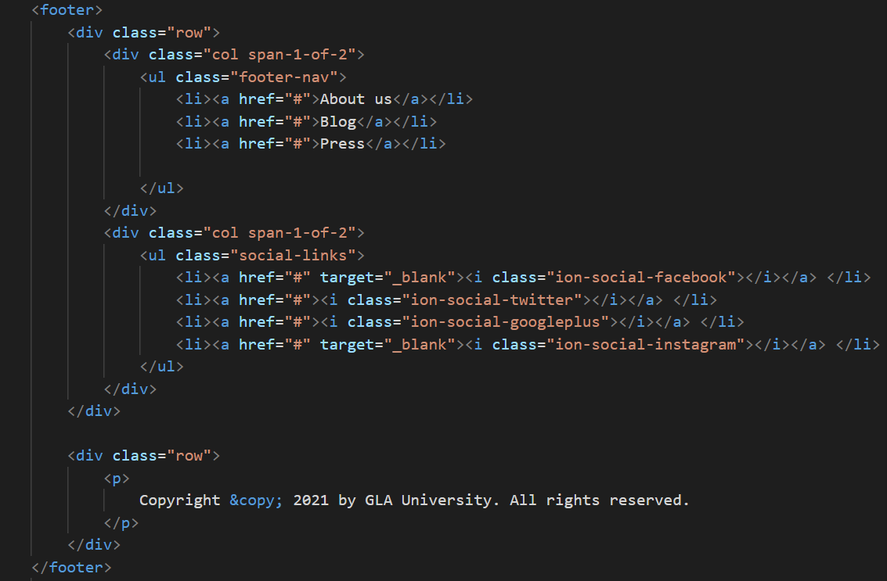

Slide 25
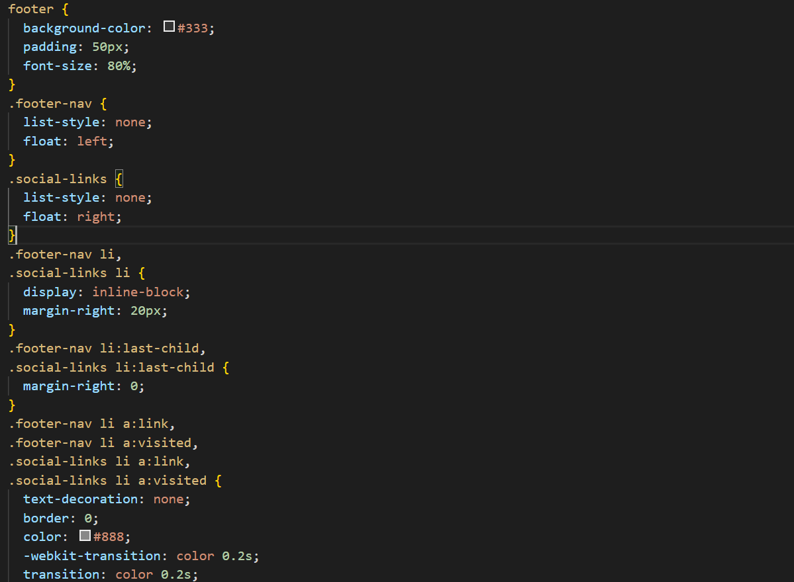

Slide 26


Slide 27
04
Implementation

Slide 28
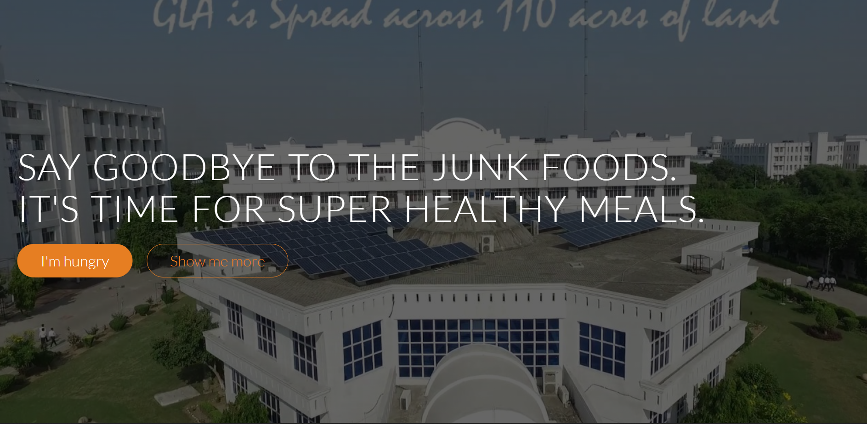
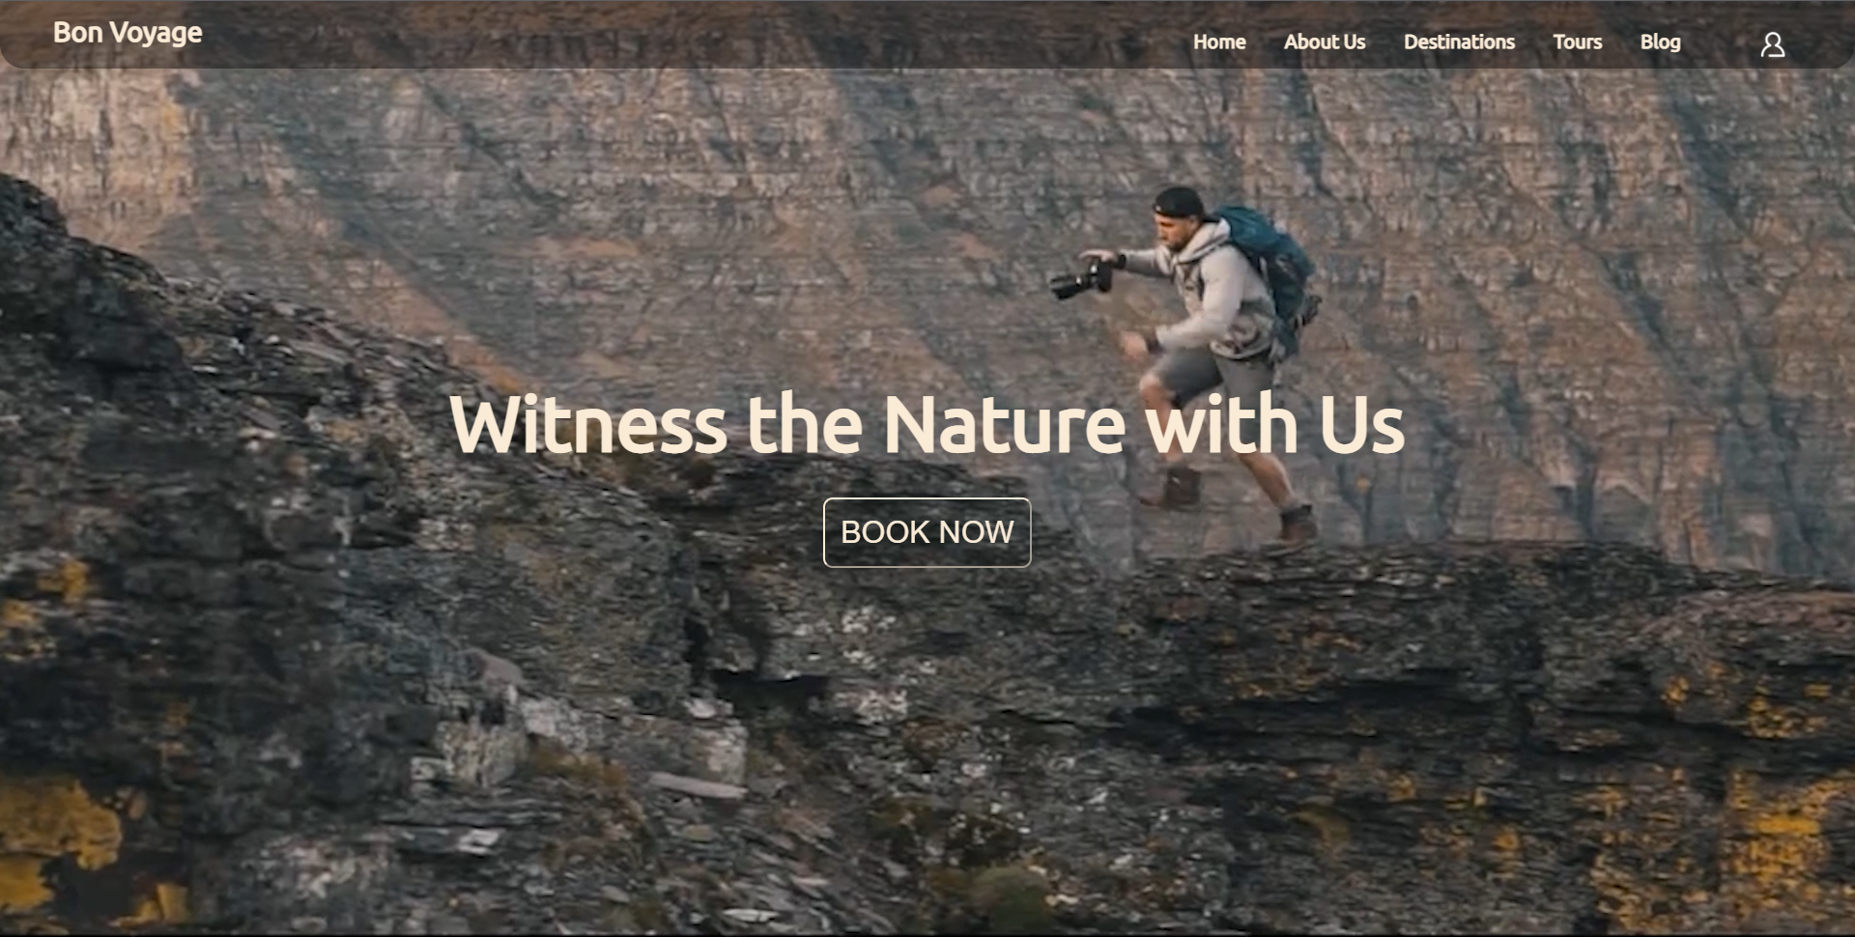
Implementation:
The website is finally implemented using HTML, CSS, and JS.
We used some pre saved Images for faster response.

Slide 29
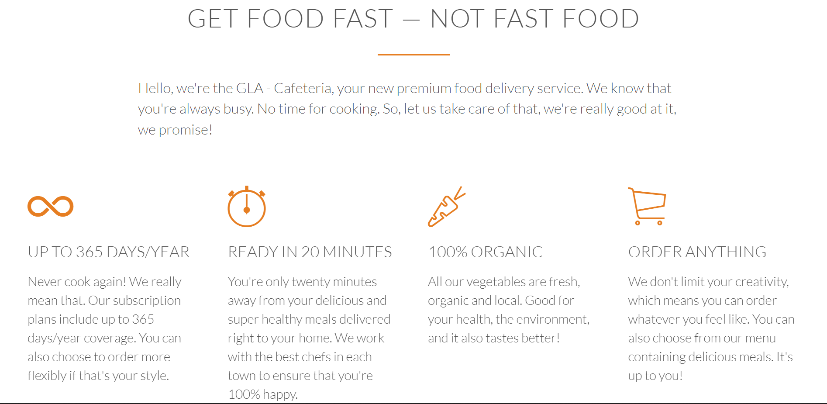
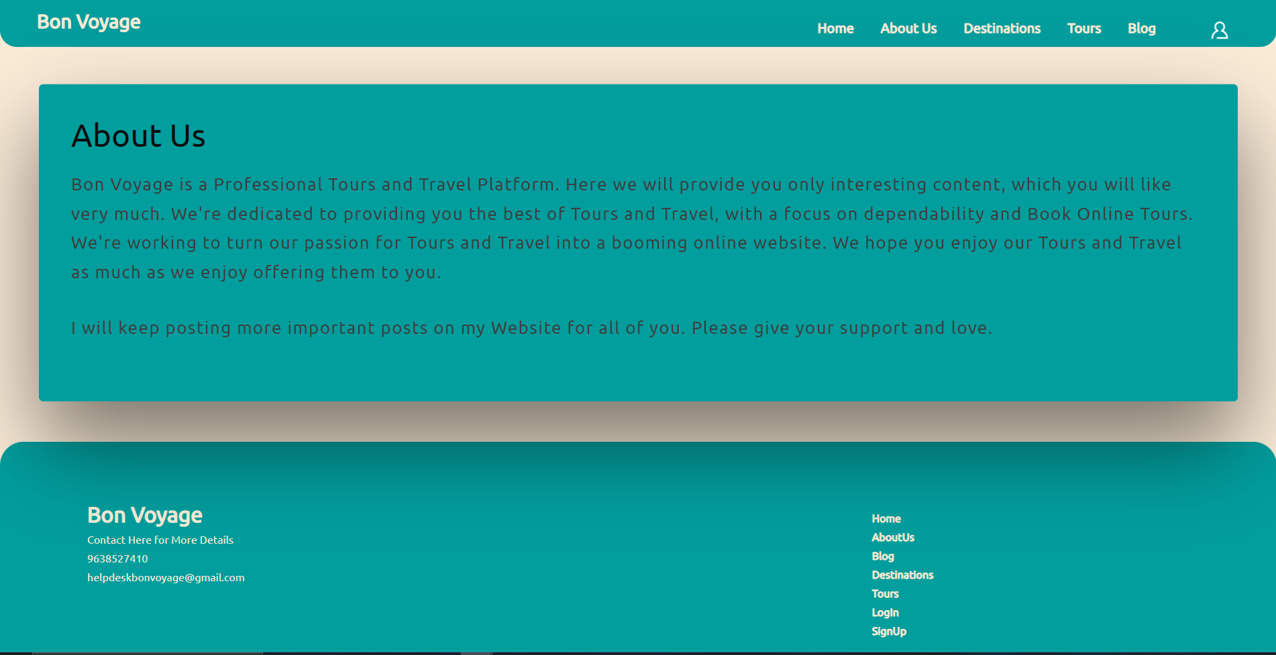
ABOUT US

Slide 30
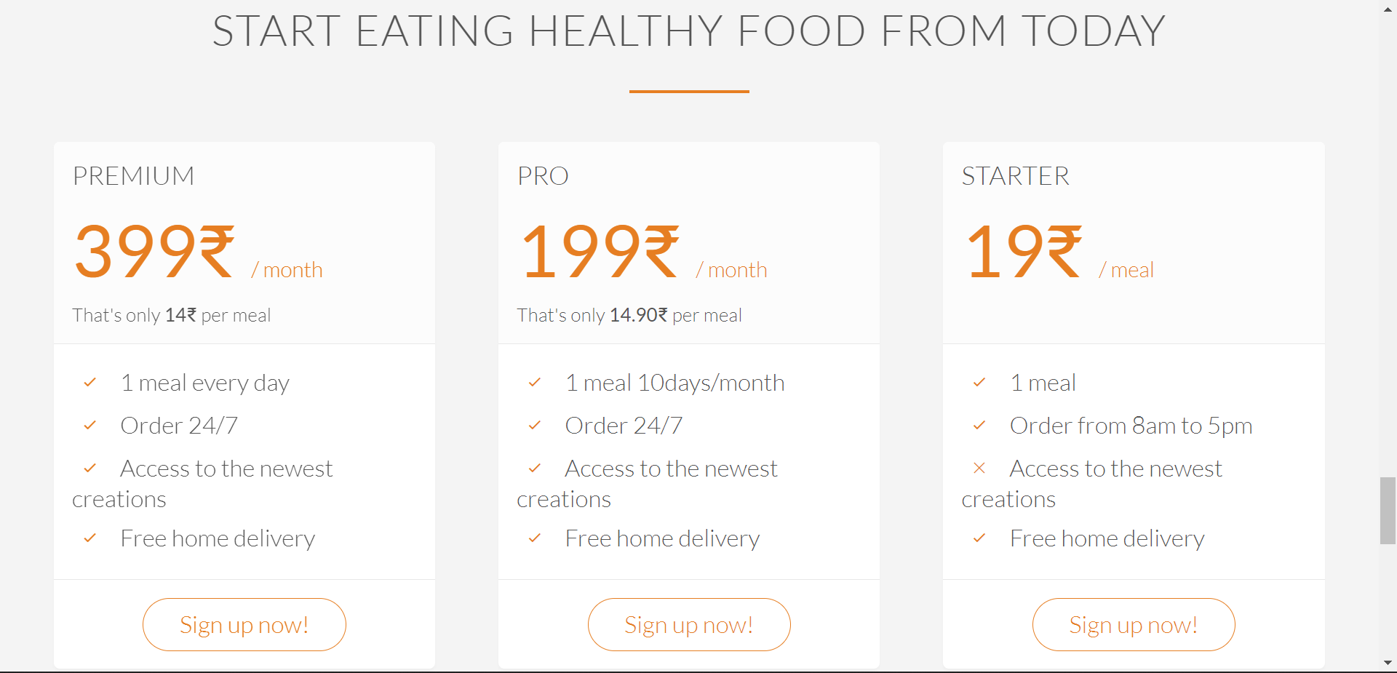
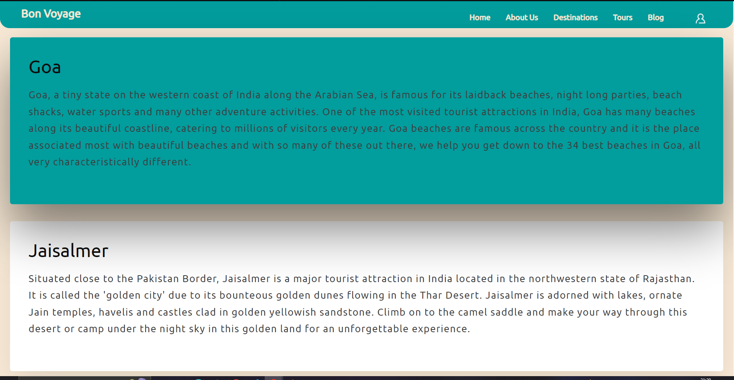
PLANS

Slide 31
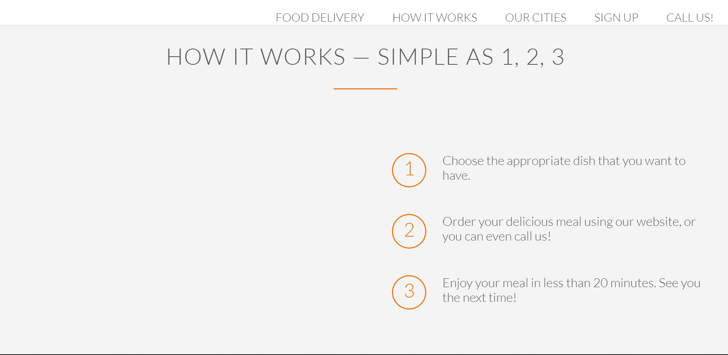
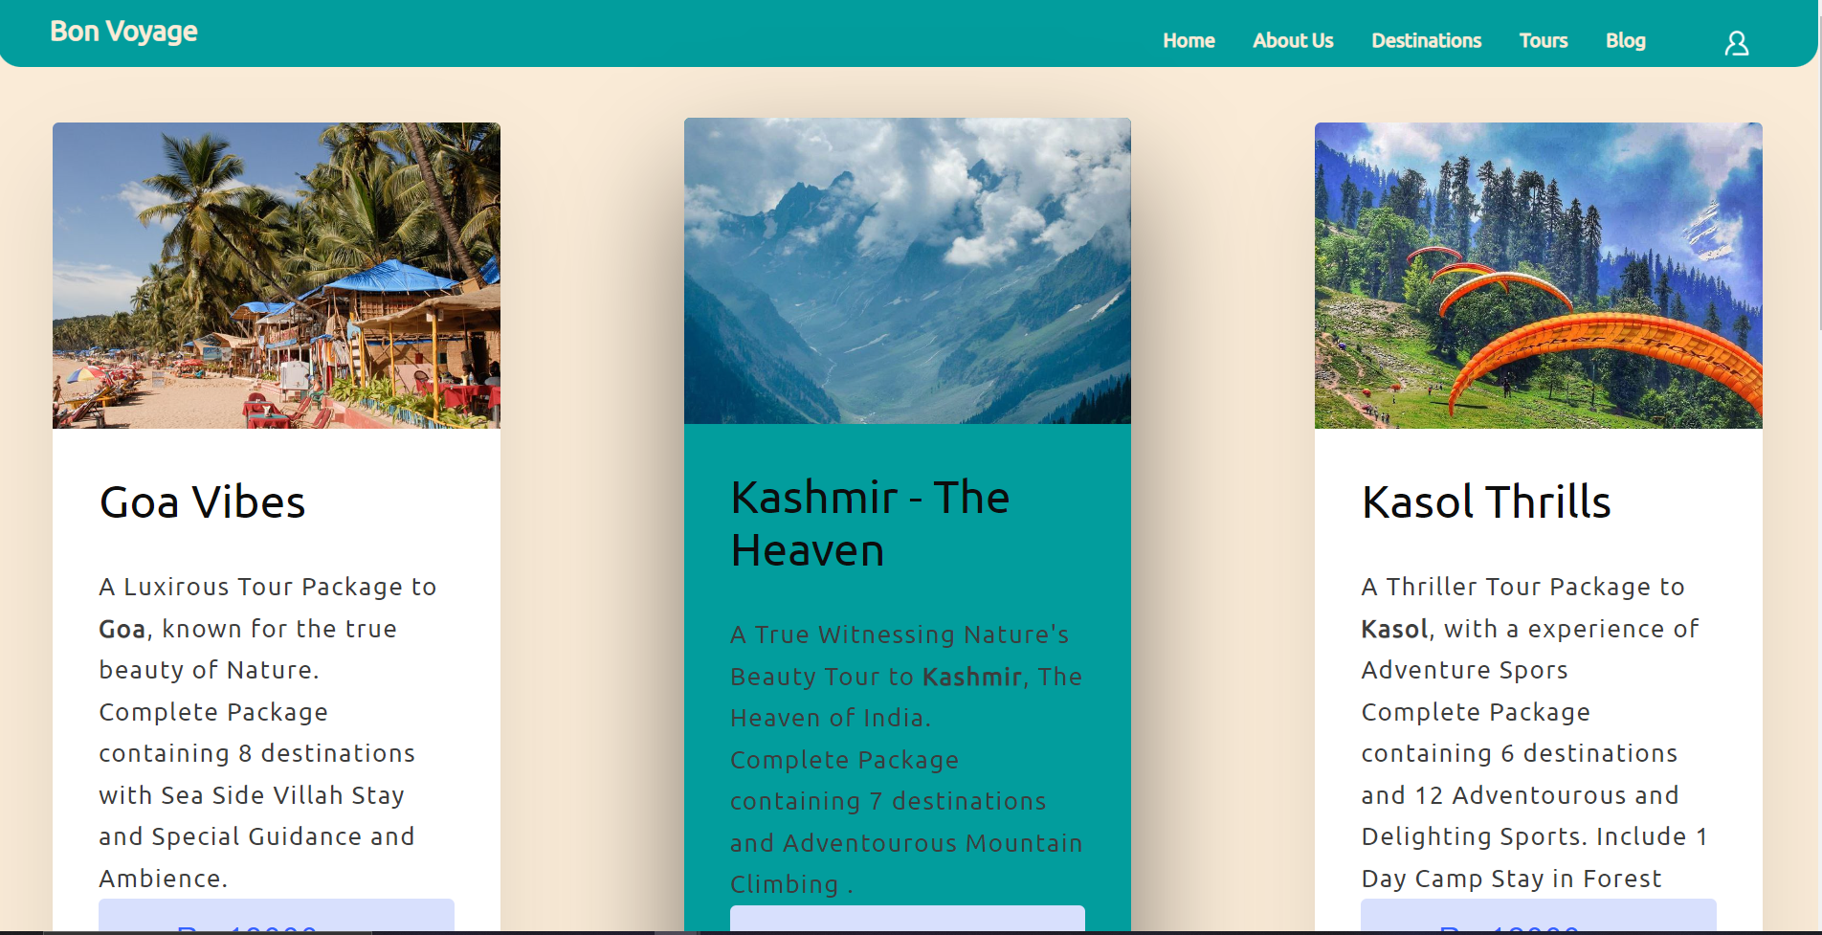
STEPS

Slide 32
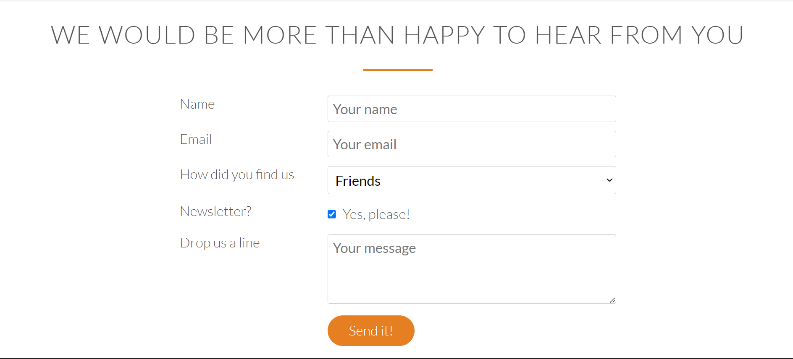
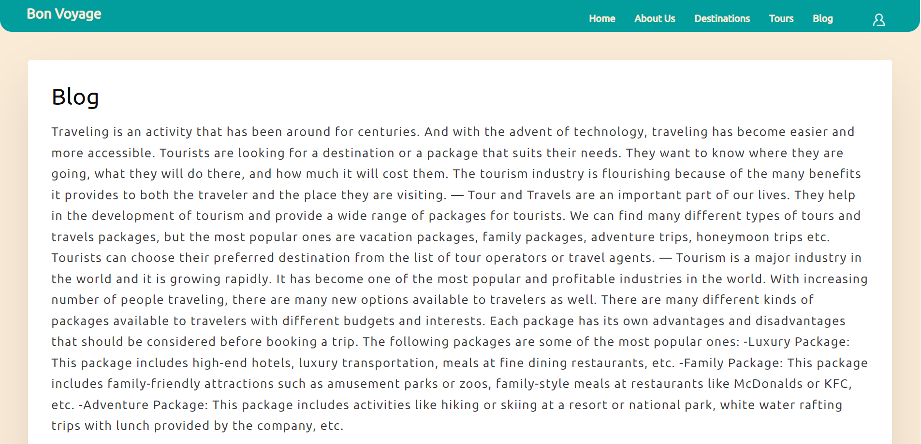
REVIEW

Slide 33
THANKS!

